Slide 1

University System
Mohamed Saeed

Slide 2

Mile Stones
Entity Relationship Diagram ERD
SQL & PLSQL
Automation Scripts
Java App

Slide 3
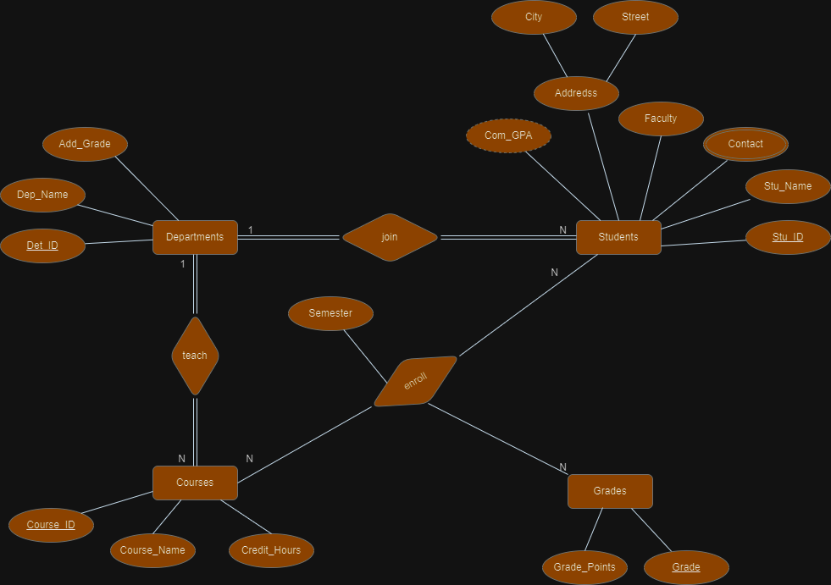
ERD:

Slide 4

SQL (Mapping):
Students (Stu_ID number primary key, Stu_name varchar2(100) not null, City VARCHAR2(50), Street VARCHAR2(50), Faculty VARCHAR2(50), Dept_ID number references Departments (Dept_ID))
Departments (Dept_ID number primary key, Dept_Name varchar2(50) unique not null, Add_Grade VARCHAR2(10)).
Courses (Course_ID number primary key, Course_Name varchar2(100) unique not null, Credit_Hours number not null).
Enrollments (Stu_ID number references Students (Stu_ID), Course_ID number references Courses (Course_ID), semester varchar2(20), Grade varchar2(3)).
Grades (Grade VARCHAR2(3) PRIMARY KEY,Grade_Points NUMBER).
Student_Contact (Stu_ID NUMBER, Contact VARCHAR2(20), PRIMARY KEY (Stu_ID, Contact),FOREIGN KEY (Stu_ID) REFERENCES Students (Stu_ID)).

Slide 5

PLSQL
PKG
add_student_to_update(proc)
calc_com_GPA (func)
process_updated_student(proc)

Slide 6
PLSQL (cont.)
CALC_AVG_GPA (Standalone Function)
UPDATE_GPA (Trigger)
Fire to update cumulative GPA in students' table.
Get the average GPA for the students enrolled in the course.

Slide 7

Automation Scripts
Bash scripts

Slide 8
Disk Space Check : make a threshold that when the usage space of the disk exceeds , a warning alert will be sent to a log file
command “ df -h | awk 'NR==2 {print $6}' | sed 's/%//’ “.
Database backup : make a copy of the database and a full backup in a safe place
command “expdp ${db_owner}/${pass}@${db} DUMPFILE=${file_name}
DIRECTORY=my_directory“.
Anomalies Check : check for any anomalies like CPU, Memory and Network anomalies happen to the system and make an alert for them.
command “ wmic CPU get loadpercentage | grep -Eo "[0-9]+“ “.
command “ netstat -e | awk '/Bytes/{printf "%.0f", $3 / (1024 * 1024)} “.

Slide 9
Java Application
“
”

Slide 10

The University Management System allows admins to perform operations such as adding, updating, and selecting information related to students, courses, grades, and departments. It also supports the assignment of courses to students and get reports about courses

Slide 11

Application components
FXML Files: are the scenes, interfaces or GUI used in the application.
Controllers Classes: are classes made of the FXML files used in handling each element in the scene and show information on the GUI using OOP concepts.
DTO Classes: are simple Java classes that are used to transfer data between software application subsystems or layers.
DAO Classes: classes typically provide methods for performing CRUD (Create, Read, Update, Delete) operations on the data source.

Slide 12
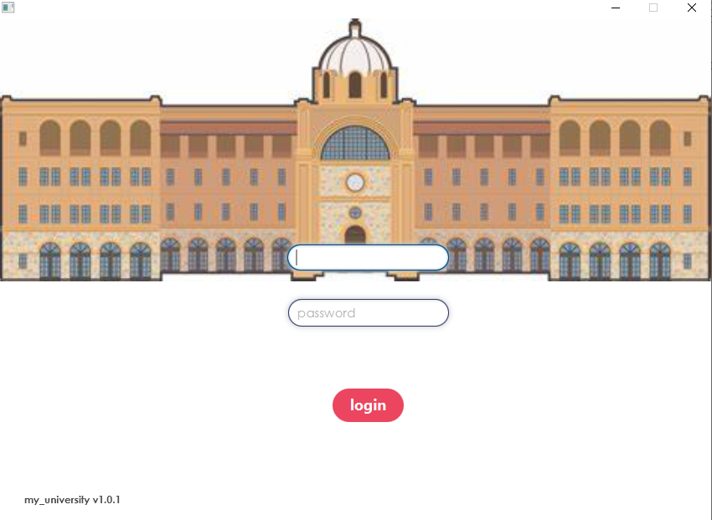

Login Scene

Slide 13
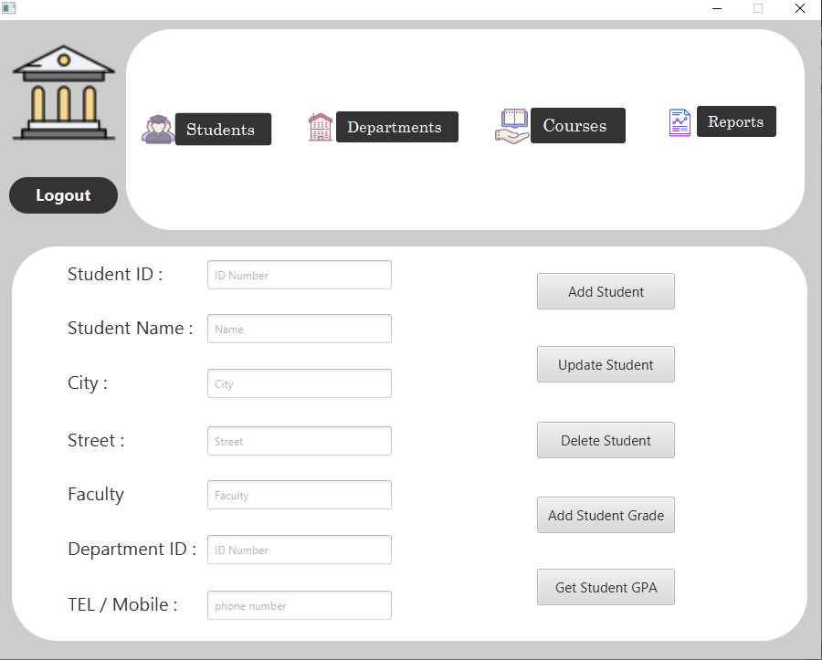

Slide 14
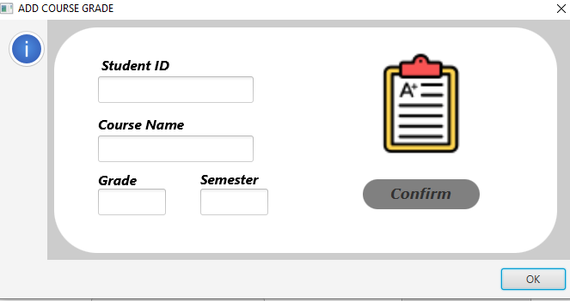

Slide 15
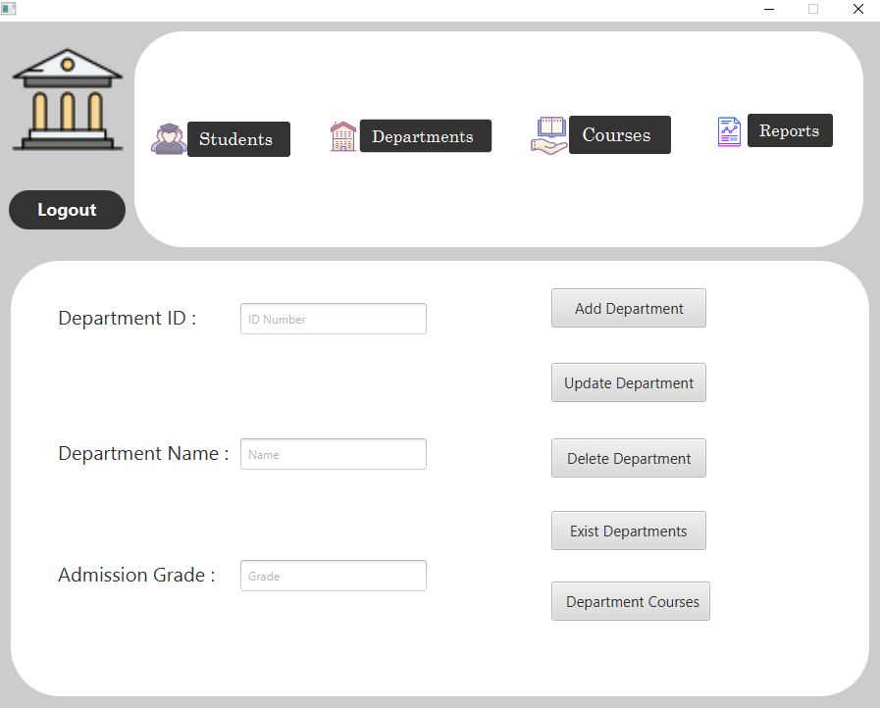
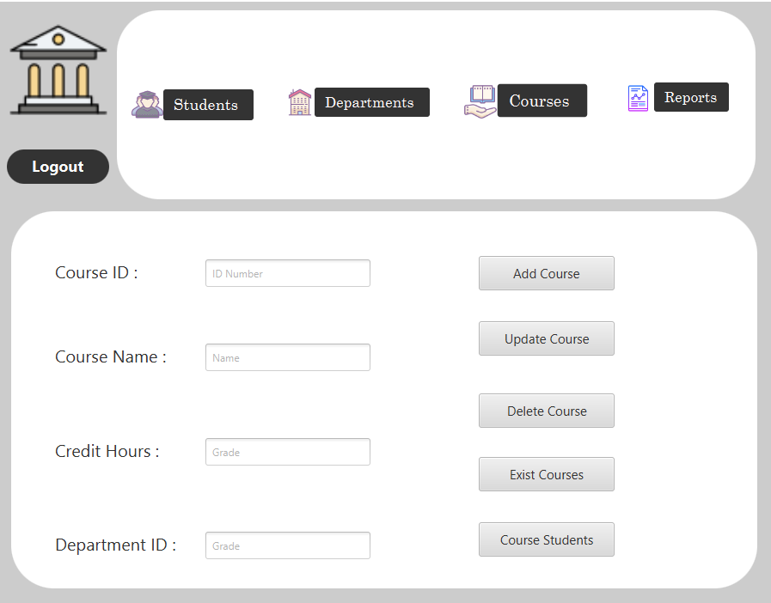

Slide 16
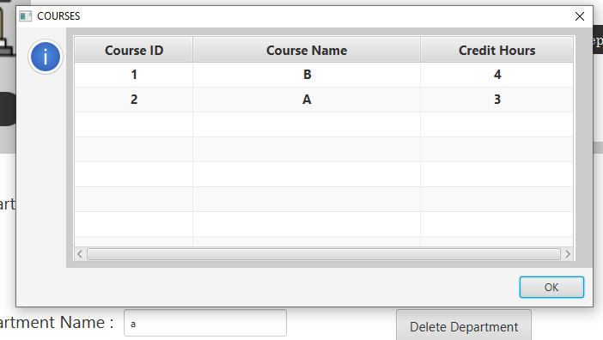
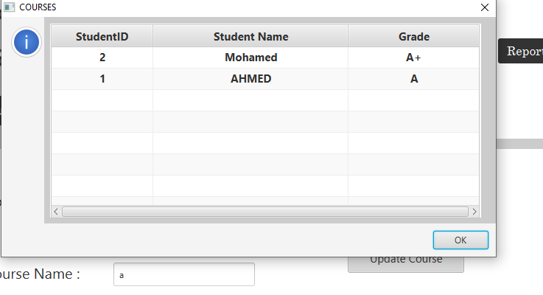

Slide 17
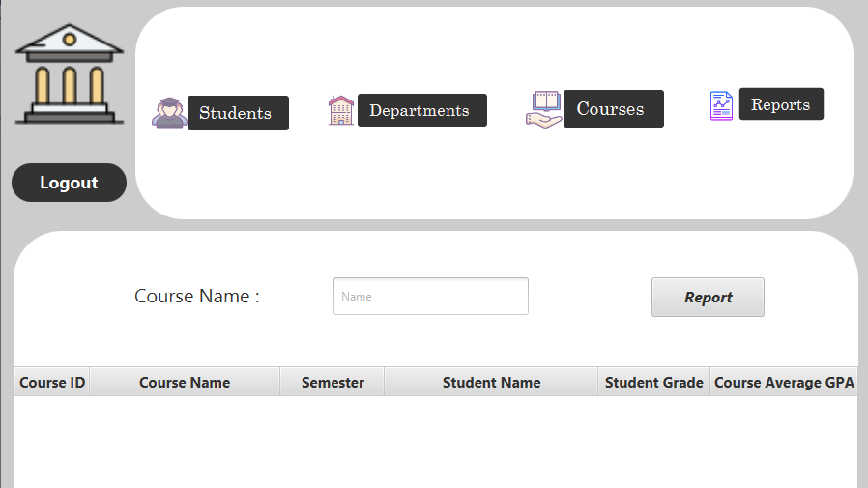

Slide 18
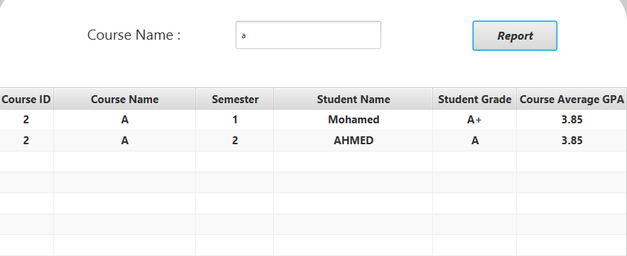

Slide 19


Slide 20


